Slide 1
Real Life Experiences Leading Large Organizational Transformation in IBM
Dibbe Edwards
Vice President,
IBM Rational DevOps Capabilities Development
IBM
October, 2014

Slide 2

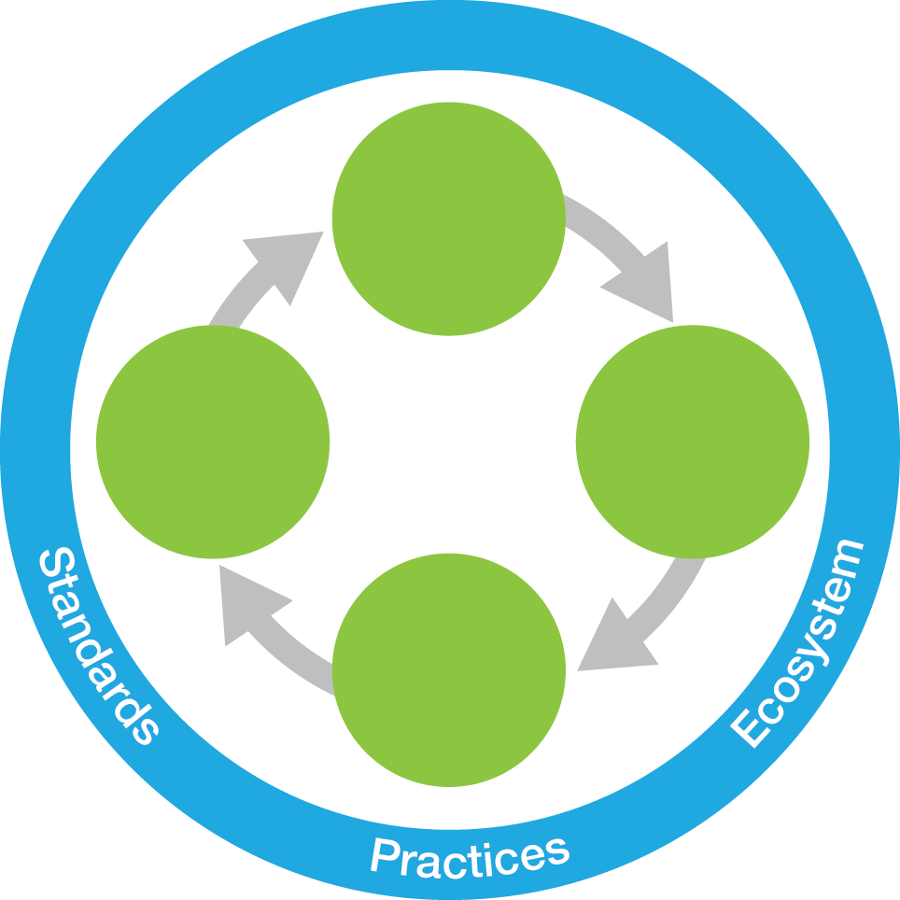

DevOps Delivers for CAMSS Cloud, Analytics, Mobile, Social, and Security
Mobile Engage customers and workforce by building secure mobile-first experiences faster, with seamless integration with enterprise systems
“if I have learned nothing else in all my years here (IBM), my biggest lesson is you have to constantly reinvent this company”
“What’s different from the past is the speed at which this is happening”
- Ginni Rometty CEO IBM
Analytics Inform applications and products by efficiently interpreting massive quantities of data
Social Business
Broader set of stakeholders collaborates to deliver continuous innovation and value
Steer
Steer
Cloud
Demand for apps requires fast, scalable environments for dev and test, as well as production
DevOps Continuous Feedback
Develop/ Test
Security Identify security vulnerabilities early in the lifecycle to mitigate downstream risk and cost
Operate
Develop/ Test
Operate
Deploy
Deploy
Notes:
Main point: Businesses who can establish software delivery as their core competency will be able to exploit the emerging technology trends
-------------------------------------------------------------------------------------------------------------------------------------------------------------------------------------
Unprecedented demands from cloud, mobile and social, and big data and analytics, instrumented products etc. are causing significant changes in how companies deliver software, requiring new levels of collaboration and innovation.
Business as usual in IT is not going to survive. Traditional software delivery methods evolved over the years across many IT industries now pose a bigger risk tan ever, resulting in loss of competitive advantage where business survival can be at stake.
TRANSITION: And majority are still taking the traditional approach when it comes to software delivery
Next slide….
* Ginni Rometty quote from Fortune magazine article October 6, 2014 “Getting Past the Big Blues”
10/22/14 01:37
Drury Design Dynamics
IBM Innovate 2013

Slide 3
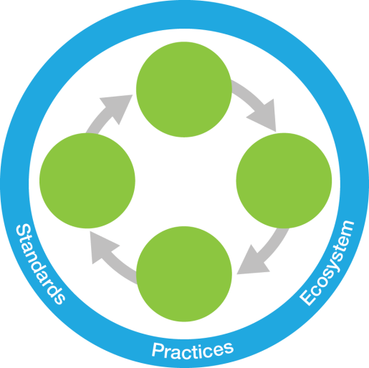
IBM’s Definition of DevOps
Accelerate software delivery –
for faster time to value
Steer
Operate
Develop/ Test
Balance speed, cost, quality and risk –
for increased capacity to innovate
Deploy
Reduce time to customer feedback – for improved customer experience
“The agile, "devops" culture will move from the software development lab to the front office. That will be required of sales and marketing, customer service, HR, product development… they (customers) will expect you to behave differently. Rapid response, iterative, fast with quality. It is a rare front office today that is ready for this.” – Ginni Rometty
CEO IBM
Notes:
3
Main point: DevOps is an enterprise capability for continuous software delivery that enables clients to seize market opportunities and reduce time to customer feedback
----------------------------------------------------------------------------------------------------------------------------------------------------------------------------------
Here is the IBM definition of DevOps. It enables clients to:
Accelerate software delivery - by enabling collaboration between customers and enterprises and eliminating organizational silos
Balance speed, cost, quality and risk- By automating manual processes and eliminating waste
Improve client experience - By speeding the customer feedback loop
Notes:
-----------------------------------------------------------------------------------------------------------------------------------------------------------------------------------------
“Companies that master effective software development and delivery in rapidly changing environments such as cloud, mobile and social will have a significant competitive advantage,” - Kristof Kloeckner, general manager, IBM Rational Software.
3

Slide 4
A Global Team of IBM Software Developers
Pittsburg
Poughkeepsie
Somers
Yorktown Heights
Hopewell Junction
Wayne
Southbury
New York City
Princeton
Hawthorne
Endicott
Bedford, MA
Bedford, NH
Essex Junction, VT
Westborough
Cambridge
Littleton
Marlborough
Edinburgh
London / Staines
Milton Keynes
Hursley
Warwick
York
US | 20,000
Canada | 3,100
Latin America | 600
EMEA | 7,100
AP | 11,800
Total | 42,600
Cork
Dublin
Galway
Stockholm
Delft
Canada
Toronto, Ottawa
Montreal, Victoria
Moscow
Krakow
Warsaw
My focus is on experiences I have in software development across managing large organizations in
Rational and WebSphere
Boeblingen
China
Beijing
Shanghai
Xian
Paris
Pornichet
Zurich
Haifa
Rehovot
Yamato
Kirkland
Seattle
Foster City
San Francisco
SVL/San Jose
Almaden
Agoura Hills
Irvine
El Segundo
Costa Mesa
Las Vegas
El Salto, MX
Fairfax
Raleigh
Charlotte
Lexington, KY
Atlanta
Boca Raton
Tampa
Cairo
Rome
Taiwan
Rochester, MN
Boulder
Denver
Lenexa, KA
Tucson
Phoenix
Austin
Dallas
Dublin
India
Bangalore
Pune
Hyderabad
Gurgaon
Vizag
Malaysia
Gold Coast
Sydney Canberra
Sao Paulo
Perth
Notes:
My focus is on experiences I have in software development across managing large organizations in
Rational and WebSphere

Slide 5
Product and Process Improvements
Lifecycle Measurements | 2008 | 2010 | 2012 – 2014 | Total Improvement
Project Initiation | 30 days | 10 days | 2 days | 28 days
Groomed Backlog | 90 days | 45 days | On-going | 89 days
Overall Time To Development | 120 days | 55 days | 3 days | 117 days
Composite Build Time | 36 hours | 12 hours | 5 hours | 700 %
BVT Availability | N / A | 18 hours | < 1hour | 17 hours
Sprint Test Time | 5 days | 2 days | 14 hours | 4 days
Total Deployment Time | 2 days | 8 hours | 4 hours -> 20 minutes | 2 days
Overall Time To Production | 9 days | 3 days | 2 days | 7 days
Time Between Releases | 12 Months | 12 Months | 3 Months | 9 Months
Innovation / Maintenance | 58% / 42% | 64% / 36% | 78% / 22% | +20% / -20%
Double-digit revenue growth, increased client adoption, improved client satisfaction, ~200K jazz.net members

Slide 6
Summary of Practices from My DevOps Journey
Expand agile practices beyond development and test to include clients, business stakeholders and operations to breakdown silos and improve outcomes.
Continuously test using automation and virtualization to eliminate long backend test cycles and increase quality.
Build a delivery pipeline leveraging tools-as-a-service that enables developers to commit code, test, and deploy to a production environment in minutes reducing the need for rework and maximizing productivity.
Experiment rapidly by delivering instrumented capabilities which enable the team to make fact-based decisions and quickly evolve towards an optimal solution.
Create a culture of continuous improvement leveraging measures of effectiveness and efficiency to ensure you’re getting better.

Slide 7
Expand Agile Practices Beyond Development and Test
Strategic Product Committee (SPC)
Core members: Product Management, Development Directors, Development Architects, Business Owners
Responsibilities:
Alignment between market opportunities, business strategy, investment allocations and execution
Prioritize and manage a groomed backlog for development organization – pivots possible at end of each sprint
End to end traceability from strategy to deployment
Faster feedback informs developers and business objectives
Epic Elaboration
Start here
Business Objectives
User Story Prioritization
Traceable
Quarterly Releases
Client Feedback
7

Slide 8

Continuously Test Using Automation and Virtualization
Cross discipline feature teams with ownership of test assets
Establishing rhythm, continuous integration, definition of done
Testing shifted left to be done as features are developed
Complex testing run continuously
Automation creation as part of the development efforts
Anything done manually analyzed for elimination, automation, or critical as manually done
Retrospectives, understanding/eliminating friction points
Warmup
Sprint 1
Sprint 2
…
End Game
Plan
Develop
Develop
Develop
Test/Fix/Test
4 weeks
4 weeks
4 weeks
Sprint 1
Sprint 2
End Game
Develop
Develop
Test/Fix
retrospective
Test
4 weeks
4 weeks
Plan
Quarterly Releases
Ship ready with each Sprint
Create a culture committed to automating everything…
8

Slide 9

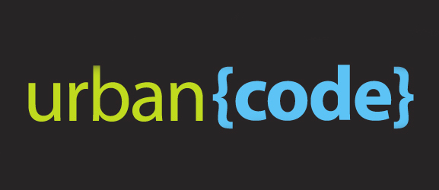
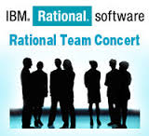

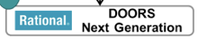

Build a Delivery Pipeline Leveraging Tools-As-a-Service
Developers launch test from their workspace
Executes 10000s of Junits & security scans
Rapid install and smoke Tests
Functional and systems tests on Golden Topologies
Build
Test (continuous)
Interactive Testing
Production
Develop
BVT
System Test
Unit Test
Function Test
Usability Test
Jazz.net
Production-Like Environment
Production-Like Environment
IBM Bluemix DevOps Services
Performance Test
Integration Test
Security Pen testing
Continuous Integration and Test
Deployments
Deploy Golden Topology
Global dev/test/ops team ~100 daily commits/deploys using our tools to build our tools
191,000 jazz.net community members, 50K sandbox instances, >105K page views
“Simply put, things always had to be in a production-ready state: if you wrote it, you darn well had to be there to get it running!”
- Mike Miller,
Co-founder and Chief Scientist at Cloudant,
an IBM Company
9
Notes:
9

Slide 10
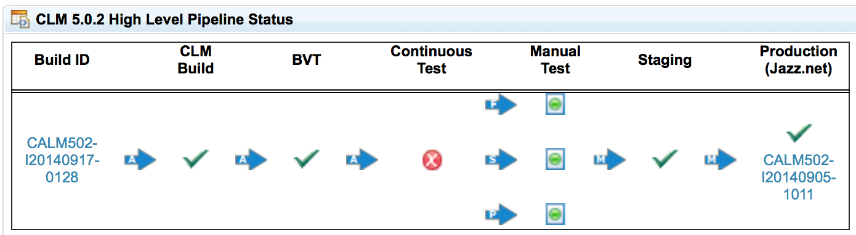
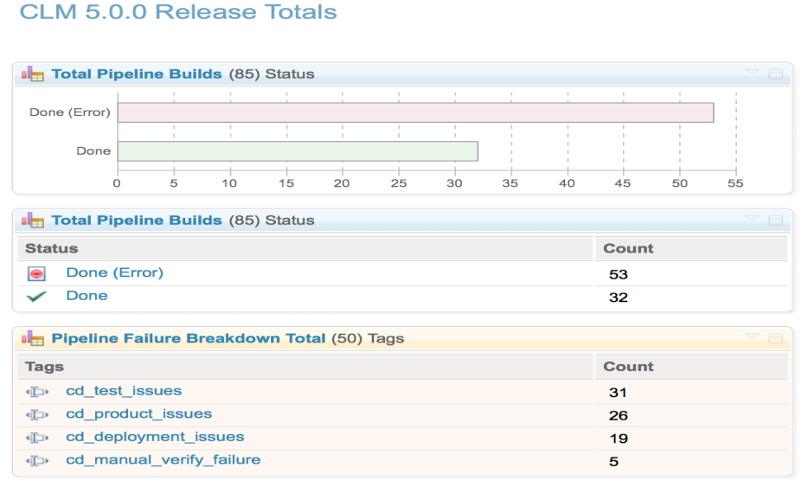
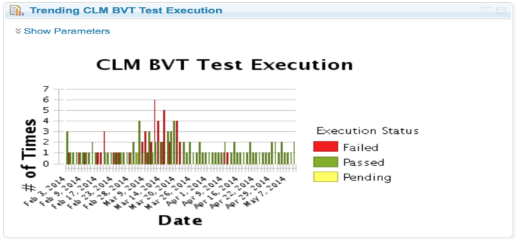
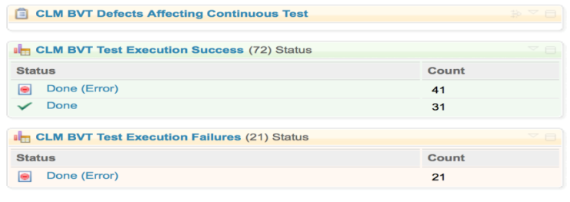
Continuous Delivery Pipeline Dashboard (CLM)
Automated quality gates
Single view of quality
Ability to quickly drill down on problems
View the live dashboard at: jazz.net

Slide 11
Experiment Rapidly by Delivering Instrumented Capabilities
Establish business metrics and success/failure criteria
Figure out what works by running experiments – tiny tests for a small subset of users to help determine the usefulness of a feature
Run experiments and compare results making fact based decisions
A mechanism to enable system-wide experimenting is highly recommended
Consider different models of experimenting (A/B testing, multi-armed bandit, etc.)
You can follow two paths simultaneously for related projects:
Experiment on a cloud-based project and use the data from the experiments to not only drive the direction of that project but related on-premise projects
CLM
(on-premise)
Experiment
IBM Bluemix
DevOps Services
(on the cloud)
11
Notes:
Google reference comes form http://googleblog.blogspot.ca/2008/08/search-experiments-large-and-small.html#uds-search-results
Complete quote:
“If you can’t out-experiment and beat your competitors in time to market and agility, you are
sunk. Features are always a gamble. If you’re lucky, ten percent will get the desired benefits.
So the faster you can get those features to market and test them, the better off you’ll be.
Incidentally, you also pay back the business faster for the use of capital, which means the
business starts making money faster, too.”
― Gene Kim
Author: The Phoenix Project

Slide 12
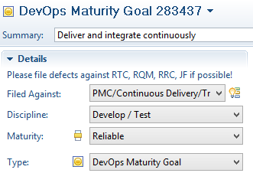
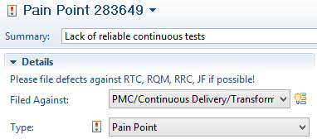
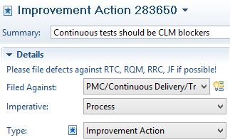
Create a Culture of Continuous Improvement
Identify and remove impediments which impact business results and drive results
Track continuous improvement actions along with other development work, prioritize and commit
Overtly decide to invest in removing technical debt
Eliminate blame culture and take ownership
Business
Metric
Impediment
Action
Prioritized
Backlog
Sprint
12
Notes:
This blog post on jazz.net contains information about how we use RTC to track continuous improvement in the context of the IBM DevOps Maturity Model
https://jazz.net/blog/index.php/2013/11/25/devops-culture-enabling-continuous-improvement-with-ibms-devops-maturity-model-and-rational-team-concert/

Slide 13
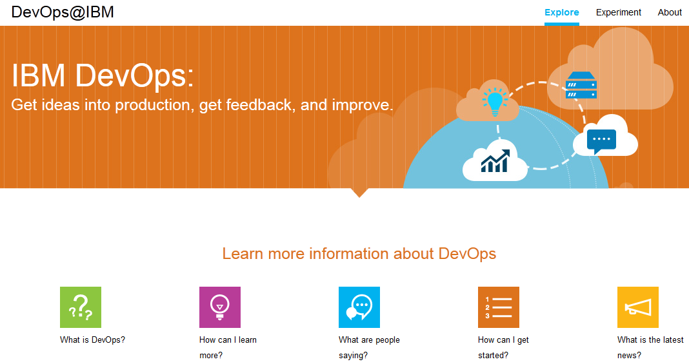
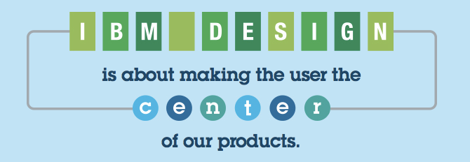
Scaling Up Across IBM
#accelerateSWG for CD Program
Attendees at DevOps Education Series
9201
Managers & Executives who have attended the three hour DevOps training
791
Onsite face-to-face education
13 completed
Onsite scheduled in 4Q2014
12
13
#accelerateSWG for CD Program
#accelerateSWG for CD Program
Notes:
This blog post on jazz.net contains information about how we use RTC to track continuous improvement in the context of the IBM DevOps Maturity Model
https://jazz.net/blog/index.php/2013/11/25/devops-culture-enabling-continuous-improvement-with-ibms-devops-maturity-model-and-rational-team-concert/

Slide 14
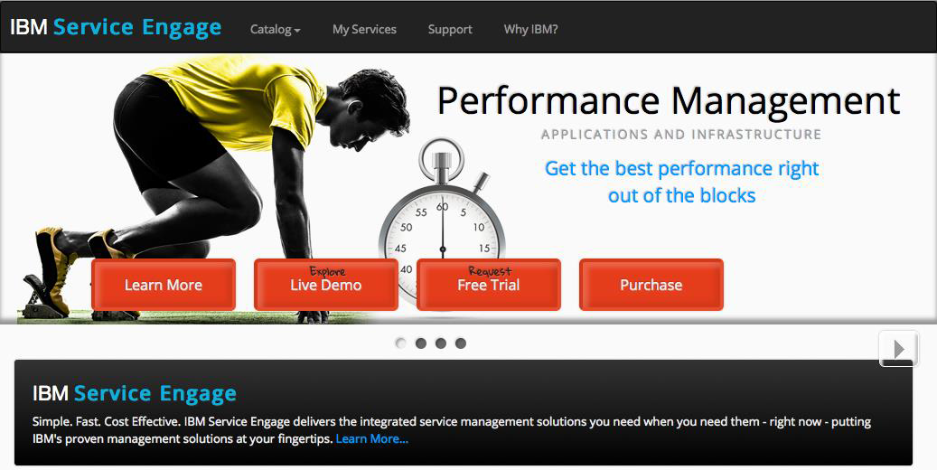
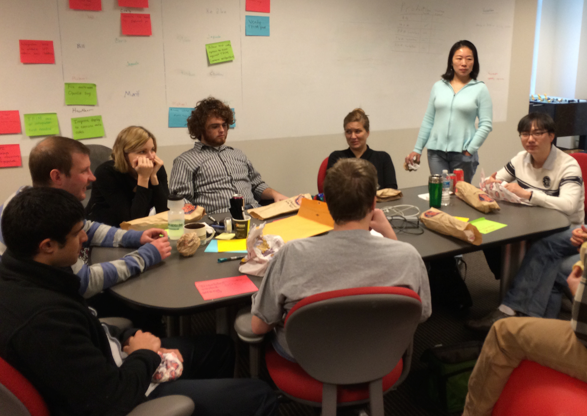
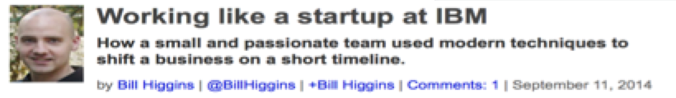
Working like a startup in IBM: IBM Service Engage Rapid delivery on Bluemix
Reduced delivery cycles Created by Went from zero lines of code to public launch at Pulse in < 5 months
Tools as a service
~ 95% of site capability provided by some other hosted service (e.g. Bluemix, Cloudant) or open source software
Working like a startup
“Two pizza team”: 6 developers, 1 tester, 1 designer, 1 STSM - all collocated in Raleigh
*http://radar.oreilly.com/2014/09/working-like-a-startup-at-ibm.html
14

Slide 15


A DevOps approach speeds IBM Watson solutions to market
Reduced delivery cycles from nine weeks to three weeks
Compact releases
better matched to customer expectations
“This is why pundits extol the virtues of DevOps—smart coordination across the three dimensions of core platform, solution applications and management environment can have amazing impact.”
— Carl Kraenzel, director of the IBM Watson managed services group, IBM Distinguished Engineer, IBM
Zero downtime
required for maintenance through continuous availability strategies
http://www.bloorresearch.com/blog/the-norfolk-punt/2014/1/ibm-watson-gets-devops/
Notes:
15
Client name
IBM
Case study link
http://www-01.ibm.com/software/success/cssdb.nsf/CS/CPAR-9CQV8Y?OpenDocument&Site=default&cty=en_us
Quote
“This is why pundits extol the virtues of DevOps—smart coordination across the three dimensions of core platform, solution applications and management environment can have amazing impact.”
—Carl Kraenzel, director of the IBM Watson managed services group, IBM Distinguished Engineer, IBM
About the company
A global computer products, services and solutions company based in the United States, IBM operates in more than 170 countries and has nearly 427,000 employees. With thousands of business partners and computer products suppliers worldwide, IBM generates more than USD99 billion in annual revenue. The company was founded in 1911 in Endicott, New York.
Solution components
Software
IBM® Rational® Team Concert™
Server
IBM Power® 750
Business challenge
In 2011, the IBM Watson computer gained widespread attention by beating two of the all-time champion human contestants, Ken Jennings and Brad Rutter, on the TV show Jeopardy! After the victory on Jeopardy!, IBM began to look for ways to apply the groundbreaking capabilities of the IBM Watson platform, which is based on IBM Power® 750 servers, to real-world problems. In May 2013, IBM announced the consumer-facing IBM Watson Engagement Advisor solution, an offering that enables companies to use the IBM Watson platform to answer contact center questions. To facilitate fast scaling of the initial consumer offering and subsequent development of additional solutions based on the IBM Watson platform, the IBM Watson teams needed to make sure they were equipped to handle a constant force shaping the IBM Watson platform and, in reality, every software development organization: the force of change.
Business solution transformation story
The IBM Watson teams are focused on properly managing change through a DevOps approach, which uses lean principles and agile development methods. The teams are using IBM Rational Team Concert™ software to support agile development within their overall DevOps approach. The IBM Watson solutions development team is currently using the planning and tracking functionality of IBM Rational Team Concert software to fully describe what a code release will contain, from the perspective of an entire product release down to each sprint release. The Rational Team Concert software also provides traceability through a self-documenting environment that enables staff to go back and view requirements, as well as the sprint in which the requirements were addressed. As part of the DevOps approach, the IBM Watson teams embraced a form of continuous availability that they call triple active. The triple active architecture is based on triple redundancy, which enables the teams to update and roll back the system without disrupting service.
Quantifiable benefits
The teams are moving from 9-week to 3-week sprints and pushing every sprint release to production, resulting in three times greater delivery velocity, reduced costs and fewer disruptions for clients. The three IBM Watson teams are closely aligned, with few boundaries among them, working together in a value-chain factory. Investing in cross-team education helps foster awareness, so teams can work together to help improve IBM Watson solutions. “The DevOps approach promotes the idea that the business stakeholders, development teams responsible for automating deployments and the operations team are all interconnected and part of a continuous delivery cycle,” says Hume. “That’s how we achieve continuous innovation.”

Slide 16
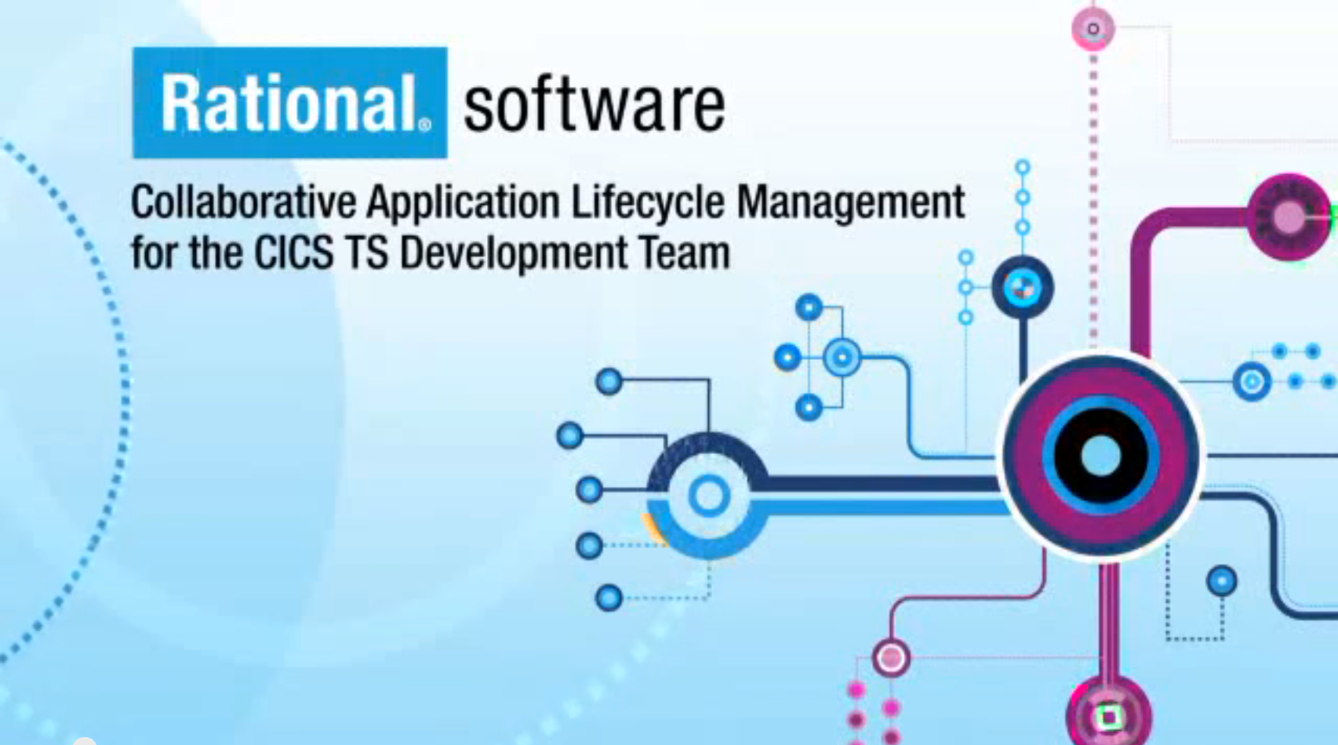

IBM Customer Information Control System (CICS) for z/OS adopts DevOps for rapid integration of feedback
Increased communication
with a standard toolset for consistency and a platform for dialogue
Increased speed
with automation and cutting release cycles by 50%
Increased responsiveness
by incorporating feedback into daily development and builds
“The idea of getting rapid feedback is really important to know you are delivering what is really needed in the marketplace.”
—Steve Mills, senior vice president and group executive, IBM Software & Systems, IBM
16

Slide 17
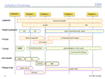


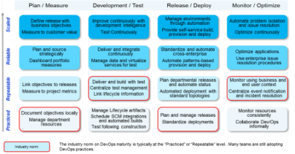

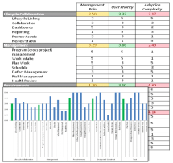



Prescription for DevOps adoption
Start with a business objective
Identify actions to fix pain points
Execute on the actions / measure results
Iterate for continuous improvement
Steer
Dev &
Test
Deploy
Operate
DevOps
Improve
Execute/Measure improvement actions to reduce or eliminate pain points
Identify pain points
and sources of
friction that impede
capabilities
Assess current capabilities using the DevOps maturity model
Establish Business Objectives
Continuous Improvement,
Identify actions, pain points, new milestones
Progress as an agile project
The DevOps Practice Assessment is a tool to guide your DevOps incremental adoption survey online https://ibm.biz/BdRVGy
Notes:
17
Main point: One size doesn’t fit all and DevOps adoption must be tailored based on organizations current gaps and business needs.
------------------------------------------------------------------------------------------------------------------------------------------------------------
The IBM DevOps maturity model is the communication tool to develop an strategy for improvements in software delivery. This model transcends organizations, practice areas, and technologies. Our practice-based model reflects the broader context of an enterprise adoption framework. It defines best practices for executing a strategy for adopting new solutions iteratively and enables clients to assess, plan, define, and deploy improvements that achieve measurable outcomes for their business. The adoption framework prescribes the steps to prepare, pilot, and release improvements into client’s business.
TRANSITION: Let’s now look at how DevOps can help support software delivery for systems of interactions, involving systems of engagement and traditional systems of records
Notes:
------------------------------------------------------------------------------------------------------------------------------------------------------------------------------------------------------------
IT has traditionally struggled with organizational design. The main issue around productivity often revolves around these bottlenecks and silos that are optimizing a particular resource group almost at the expense of everybody else so what we found is that instead of managing work based on what’s best for the network guys or what’s best for the server guys or what’s best for the developers, we really need to manage work based on what's best for the company. That means that you have to take a flow-based approach where what is important is completing the project and hitting goals. The project is not complete until all of the groups are done, and this notion is hard to understand for many folks in IT.
It doesn't matter how fast the pilot or the flight attendants get on the plane, but it matters when the last passenger gets on the plane so you can shut the cabin door and actually take off . I often joke when I am on the airplane, saying we are all going to take off at the same time. Being first doesn't matter! This notion of managing constraints in IT organizations is really important.
-Kevin Behr Read more: http://insights.wired.com/profiles/blogs/the-ultimate-experimenter-an-interview-with-phoenix-project-co#ixzz2hubeszZZ
----------------------------------------------------------------------------------------------------------------------------------------------------------------------------------------------------------
One of the first steps in the adoption framework, shown here is to assess your current maturity level and decide on the scope, architecture, and roadmap for adoption or improving your enterprise DevOps capability.
Activity in the adoption framework
Assess and decide: Assess your current maturity and decide on the scope, architecture, and roadmap for adopting or improving your enterprise DevOps capability.
Establish a core team: Establish a leadership and mentoring group to drive the improvements/adoption and support a broader, virtual team of subject matter experts.
Define a working model: Define a usage model that addresses processes and activities for each role, as well as tool configurations and supporting architecture for the capabilities planned in the pilot. This will then be used for user acceptance test of the solution and by the pilot teams during the pilot.
Prepare for a pilot: Define pilot outcomes/objectives and measurements for validating the objectives. Using the usage model, produce assets to support introducing the solution to pilot teams. Assets may include training, job aids, plugins, reports, and queries.
Pilot the project(s): Use defined improvements with real data in a production project or initiative. Measure objectives, validate the usage model, and then improve the solution for the next pilot/release.
Execute the adoption strategy: Following the pilot, deploy the capability or capabilities piloted across organizations, technologies, and applications according to the roadmap. Release The release is a well-defined improvement that produces measurable outcomes for users, teams, projects, programs, departments, and the enterprise.

Slide 18

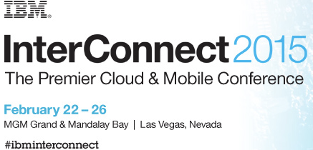
Areas where I could use help:
On Prem/Cloud based offerings
Enterprise Scale
Tips on how leaders have empowered teams to accelerate transformation
Stay in touch: @dibbeedwards, dibbed@us.ibm.com
Blog: https://www.ibm.com/developerworks/community/blogs/invisiblethread
18
Notes:
This blog post on jazz.net contains information about how we use RTC to track continuous improvement in the context of the IBM DevOps Maturity Model
https://jazz.net/blog/index.php/2013/11/25/devops-culture-enabling-continuous-improvement-with-ibms-devops-maturity-model-and-rational-team-concert/

Slide 19

Learn more at: http://www.ibm.com/ibm/devops/us/en/
© Copyright IBM Corporation 2014. All rights reserved. The information contained in these materials is provided for informational purposes only, and is provided AS IS without warranty of any kind, express or implied. IBM shall not be responsible for any damages arising out of the use of, or otherwise related to, these materials. Nothing contained in these materials is intended to, nor shall have the effect of, creating any warranties or representations from IBM or its suppliers or licensors, or altering the terms and conditions of the applicable license agreement governing the use of IBM software. References in these materials to IBM products, programs, or services do not imply that they will be available in all countries in which IBM operates. Product release dates and/or capabilities referenced in these materials may change at any time at IBM’s sole discretion based on market opportunities or other factors, and are not intended to be a commitment to future product or feature availability in any way. IBM, the IBM logo, Rational, the Rational logo, Telelogic, the Telelogic logo, and other IBM products and services are trademarks of the International Business Machines Corporation, in the United States, other countries or both. Other company, product, or service names may be trademarks or service marks of others.
Notes:
19
19

